Slide 1
CAPSTONE PROJECT
HOTEL BOOKING ANALYSIS

Slide 2
PUBLICATION
Our booking analysis shows clear patterns across hotel types, lead times, arrivals, cancellations, and stay preferences. Guests book City Hotels more for weeknights, hinting at business travel, while Resort Hotels attract longer weekend stays. Lead times reveal how early guests plan their trips, with peaks during holidays and busy months. Arrival dates by month and week show strong seasonality. The is _ canceled data highlights trends in booking cancellations, helping forecast occupancy more accurately. Overall, these insights help hotels fine-tune pricing, promotions, and operations for better guest experiences and revenue.
BOOKING ANALYSIS
Our guest analysis reveals valuable insights into booking demographics. Most bookings include adults only, but a notable share also includes children, showing the importance of family-friendly services. Bookings with babies are fewer but highlight the need for amenities like cribs and baby care facilities. By linking these patterns with booking _id, we can better understand guest profiles and tailor services to meet the needs of solo travelers, couples, and families alike — ultimately enhancing guest satisfaction and loyalty.
GUEST ANALYSIS

Slide 3
Our reservation analysis uncovers trends in booking confirmations, cancellations, and modifications. By tracking reservation status and status date, we can identify when guests are most likely to cancel or change plans, helping to adjust inventory and overbooking strategies. The ADR (average daily rate) linked with booking id highlights how reservation changes impact revenue. These insights support smarter forecasting, pricing decisions, and more efficient reservation management to maximize occupancy and revenue.
RESERVATION ANALYSIS
Our analysis shows clear links between guest meal preferences, spending, and special requirements. Popular meal plans drive higher ADR (average daily rate), indicating upselling opportunities. Data on required car parking space highlights the share of guests arriving by car, helping optimize parking capacity. The total of special requests reveals how often guests seek personalized services, which can enhance satisfaction when managed well. By connecting these factors with booking id, we gain actionable insights to refine meal offerings, upsell add-ons, and improve overall guest experience.
MEAL & STAY ANALYSIS
This analysis highlights where guests come from, how they book, and their loyalty patterns. The country column shows key source markets, helping target promotions geographically. Market segment ID and distribution channel ID reveal which sales channels drive the most bookings. The repeated guest and previous booking data show guest loyalty and cancellation behavior, while deposit type and agent columns indicate booking security and intermediary roles. Combined with customer type and booking ID, these insights help refine marketing strategies, manage cancellations, strengthen partnerships with agents, and boost repeat business.
BOOKING SOURCES & HISTORY ANALYSIS

Slide 4



OBJECTIVE: The objective of this Power BI dashboard for Hotel Booking Analysis is to provide clear, data-driven insights into booking patterns, guest behavior, lead times, cancellations, and stay trends. By visualizing this information, the dashboard helps hotel managers and stakeholders make informed decisions to optimize occupancy, adjust pricing strategies, manage demand more effectively, and enhance the overall guest experience — ultimately supporting better revenue management and business growth.
ANALYSIS SCOPE : The scope of this Power BI dashboard for Hotel Booking Analysis focuses on examining key booking metrics such as hotel type, lead time, arrival dates, stay patterns for weekdays and weekends, and cancellation trends. It covers seasonal demand, booking behaviors, and occupancy patterns to provide a clear view of how, when, and why guests book. This analysis helps identify revenue opportunities, forecast demand, manage cancellations, and support strategic decisions for pricing, promotions, and operational planning to maximize hotel performance.
GOAL : The goal of this Power BI dashboard for Hotel Booking Analysis is to turn booking data into clear, actionable insights that help hotel managers and stakeholders understand guest booking patterns, lead times, seasonal trends, and cancellation behaviors. By doing so, the dashboard aims to support smarter decisions to optimize occupancy rates, adjust pricing strategies, manage demand more efficiently, and design targeted promotions — ultimately boosting revenue and improving the overall guest experience.

Slide 5



INSIGHT & RECOMMENDATION:The hotel booking analysis shows clear patterns in guest preferences, lead times, and stay durations, revealing peak periods and higher cancellation risks during certain seasons. Guests often prefer city hotels for short business stays and resort hotels for longer weekend getaways. To maximize occupancy and revenue, it’s recommended to adjust pricing dynamically during high-demand periods, offer targeted promotions for off-peak times, and implement flexible cancellation policies. Enhancing guest experience with tailored offers can also boost repeat bookings and customer loyalty.
REPORT & PRESENTATION:This Power BI dashboard report and presentation for Hotel Booking Analysis provides a concise overview of key booking trends, guest behavior, and stay patterns. It highlights insights on lead times, peak booking periods, cancellation trends, and hotel preferences across city and resort stays. The visuals and findings help stakeholders quickly understand occupancy drivers and revenue impacts. This report supports data-driven discussions and decision-making, enabling the team to plan pricing strategies, manage demand, and design targeted promotions to boost bookings and enhance guest satisfaction.
POWER_BI DASHBOARD:This Power BI dashboard for Hotel Booking Analysis provides a clear snapshot of key booking trends, including lead times, peak arrival periods, cancellation rates, and stay patterns for both city and resort hotels. By visualizing this data, the dashboard helps identify seasonal demand, guest preferences, and occupancy gaps. These insights empower hotel managers to adjust pricing, forecast demand more accurately, create targeted offers, and optimize room allocation — ultimately driving better revenue performance and guest satisfaction.

Slide 6
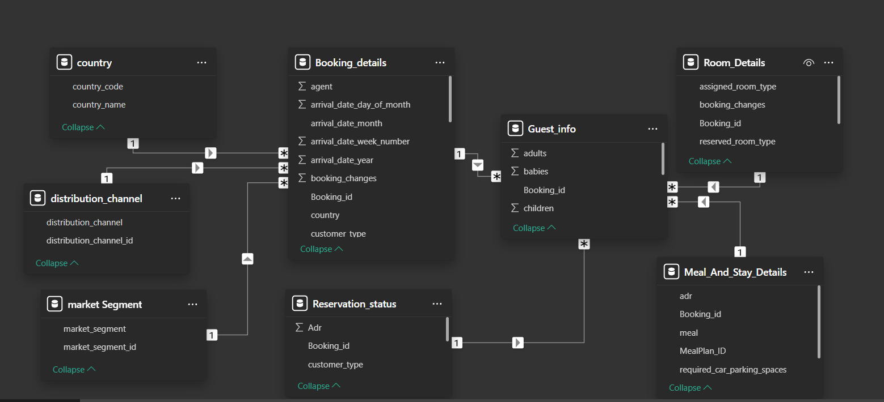
Er diagram

Slide 7
Power bi problem statement

Slide 8
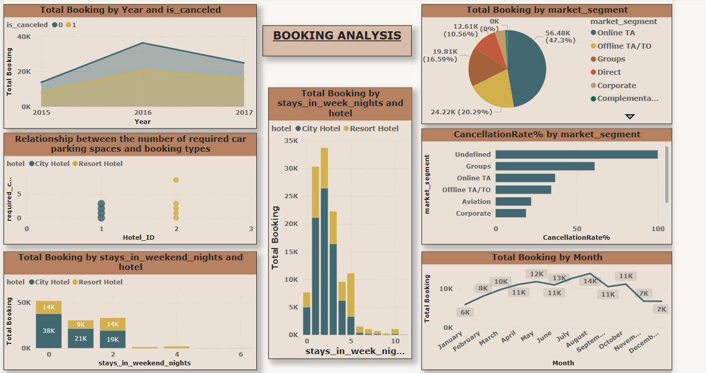

Slide 9
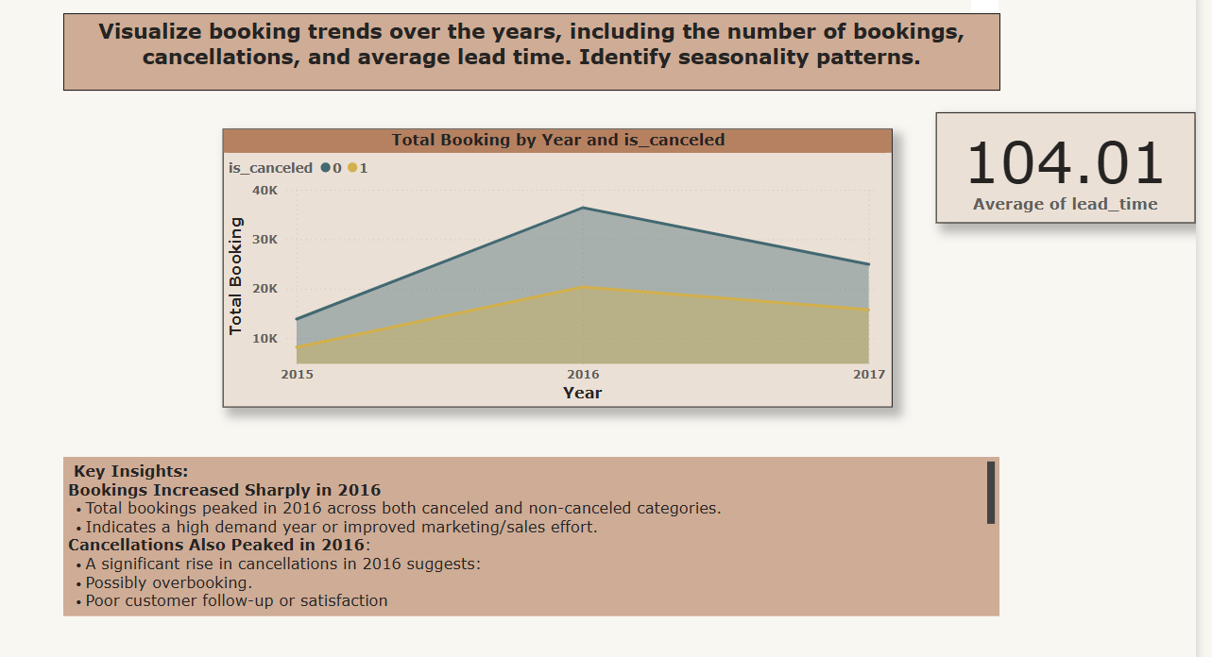

Slide 10
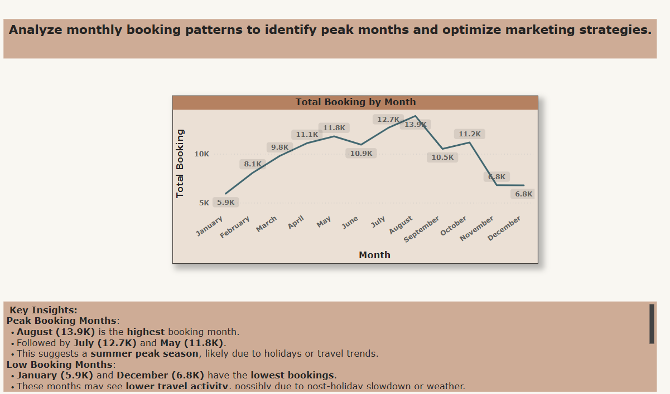

Slide 11
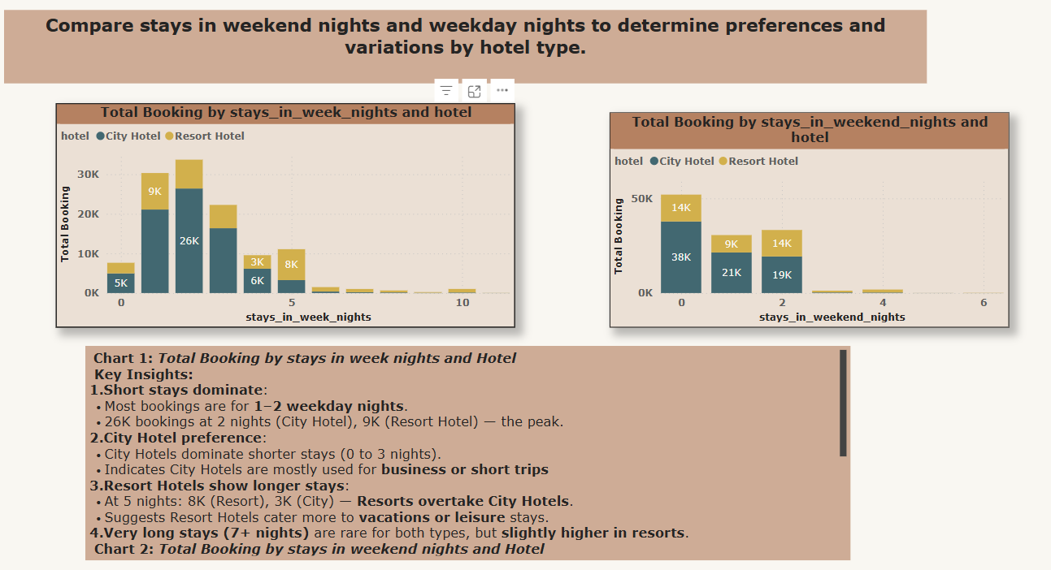

Slide 12
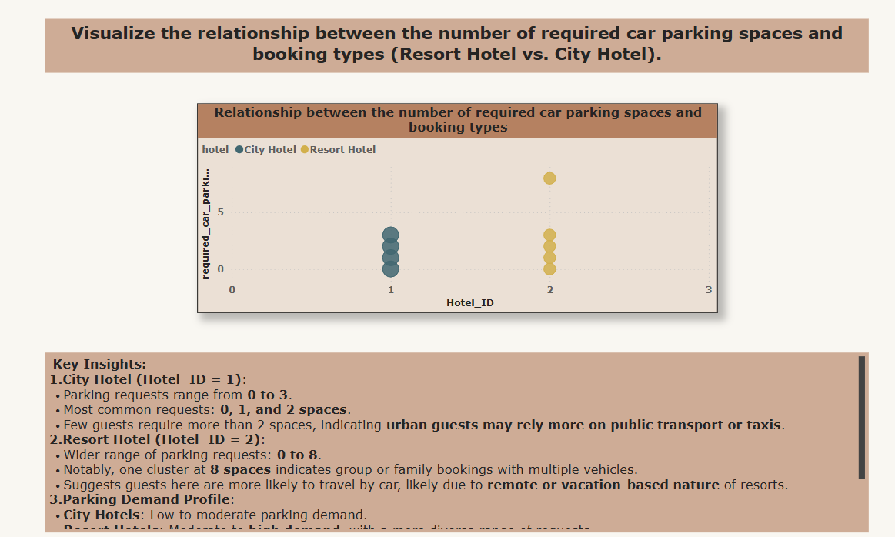

Slide 13
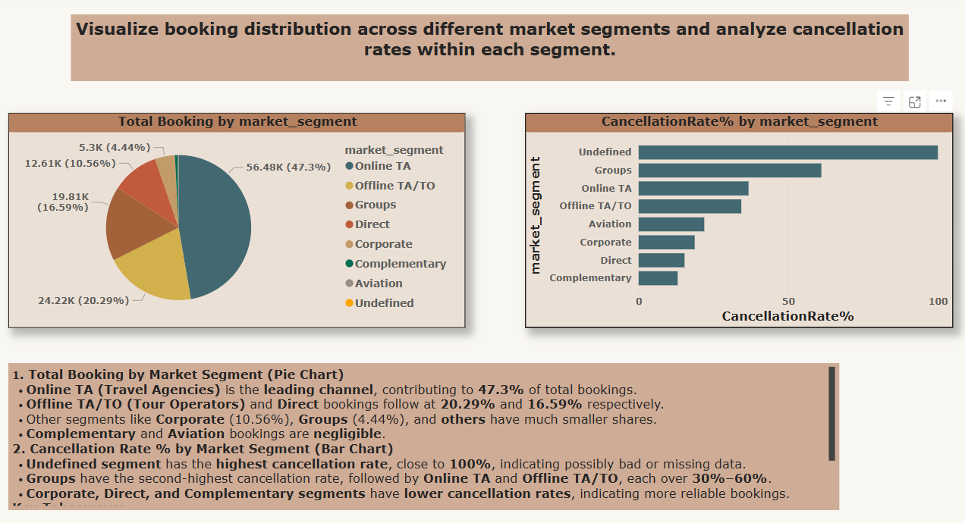

Slide 14
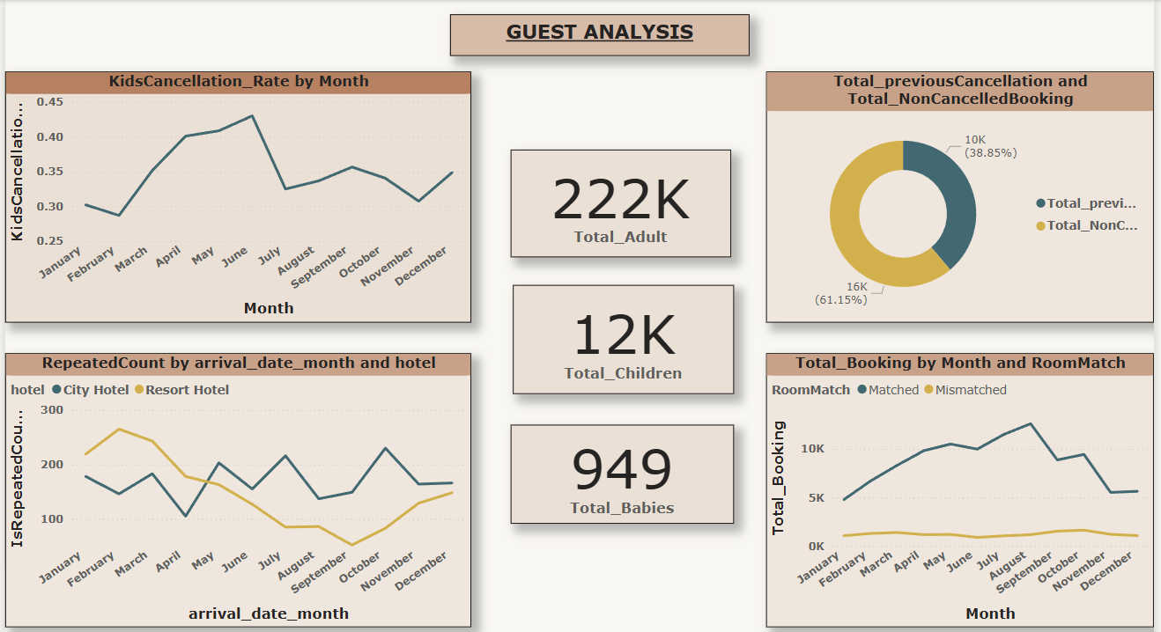

Slide 15
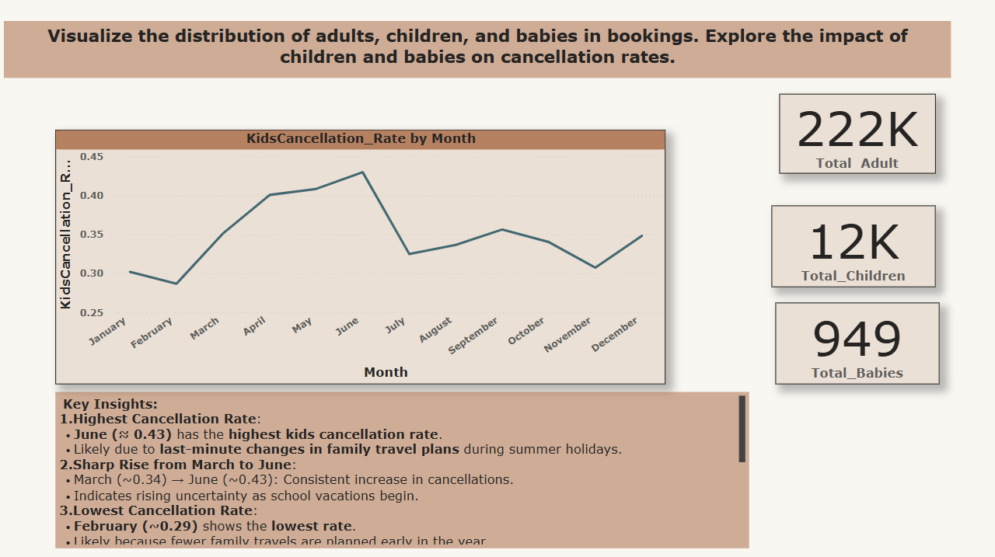

Slide 16
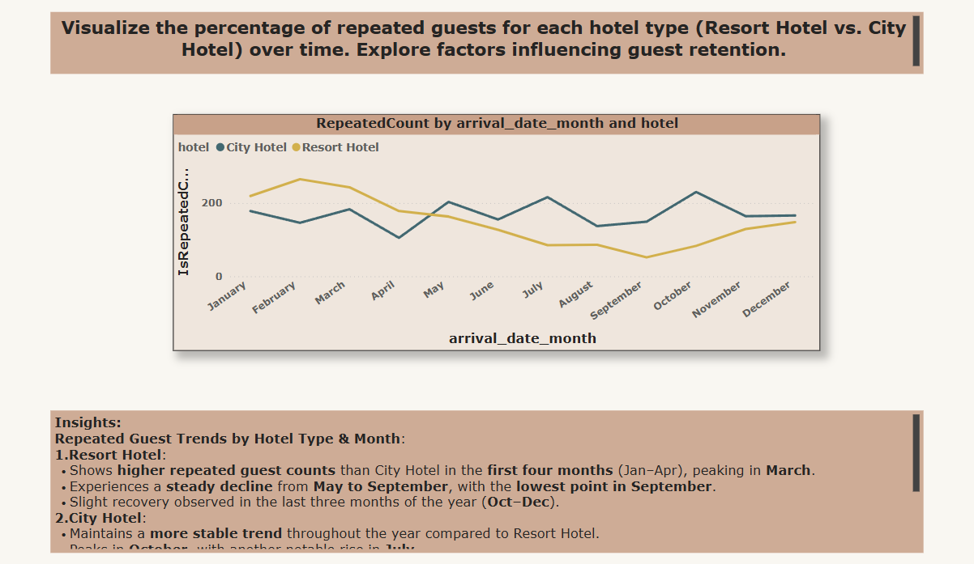

Slide 17
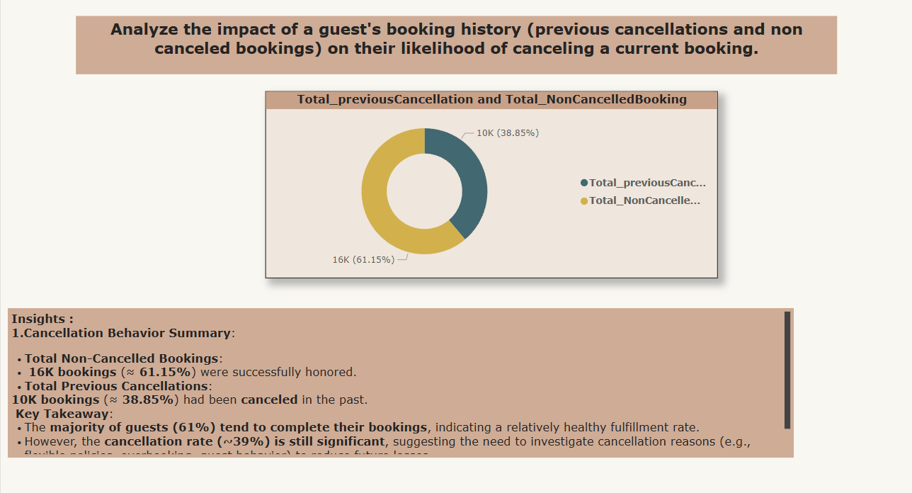

Slide 18
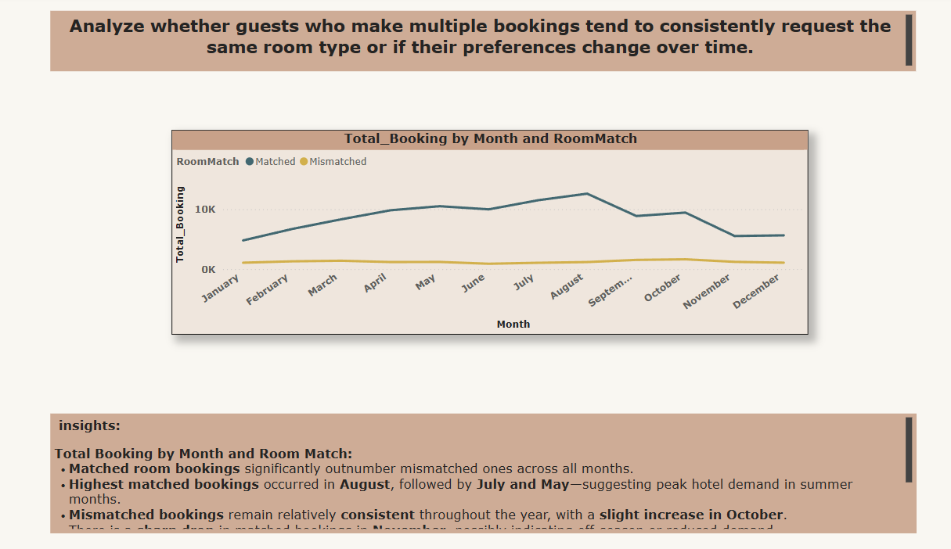

Slide 19
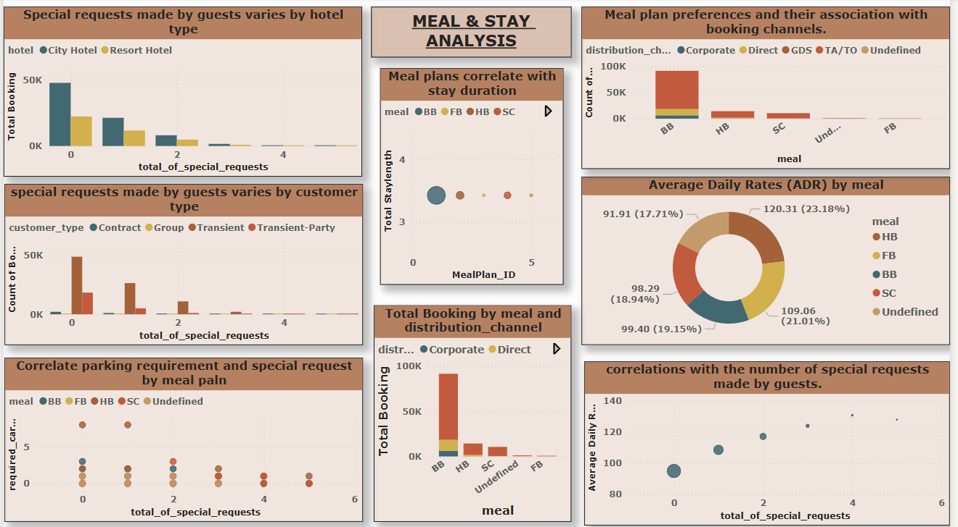

Slide 20
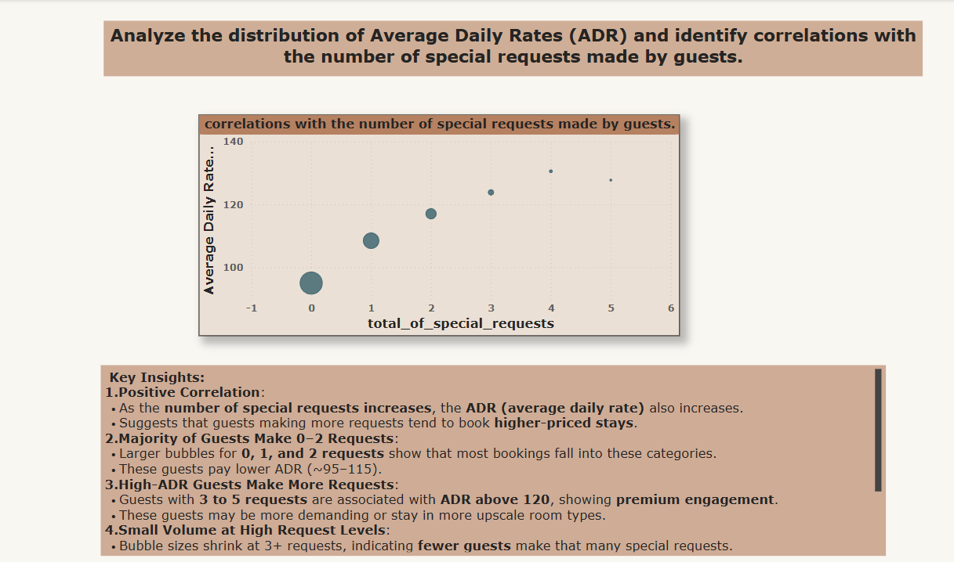

Slide 21
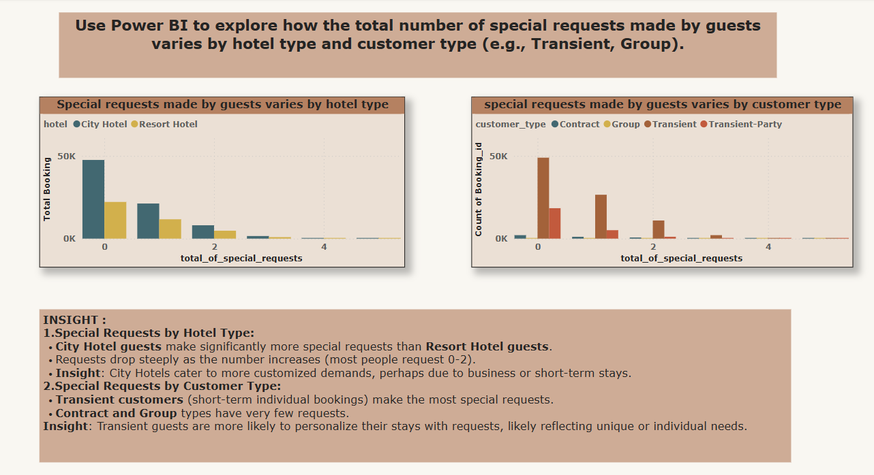

Slide 22
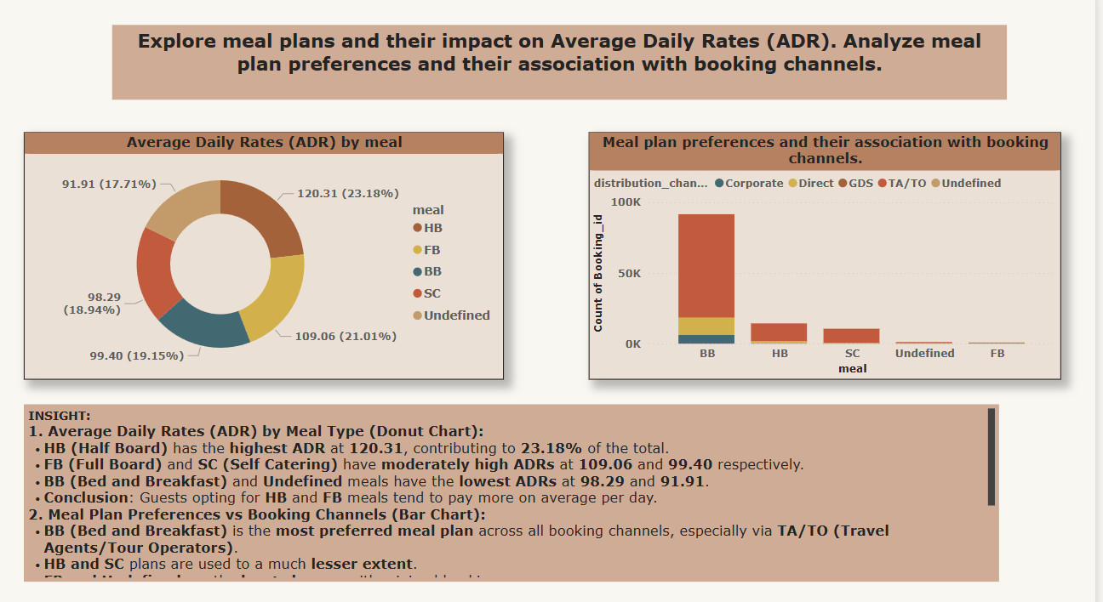

Slide 23
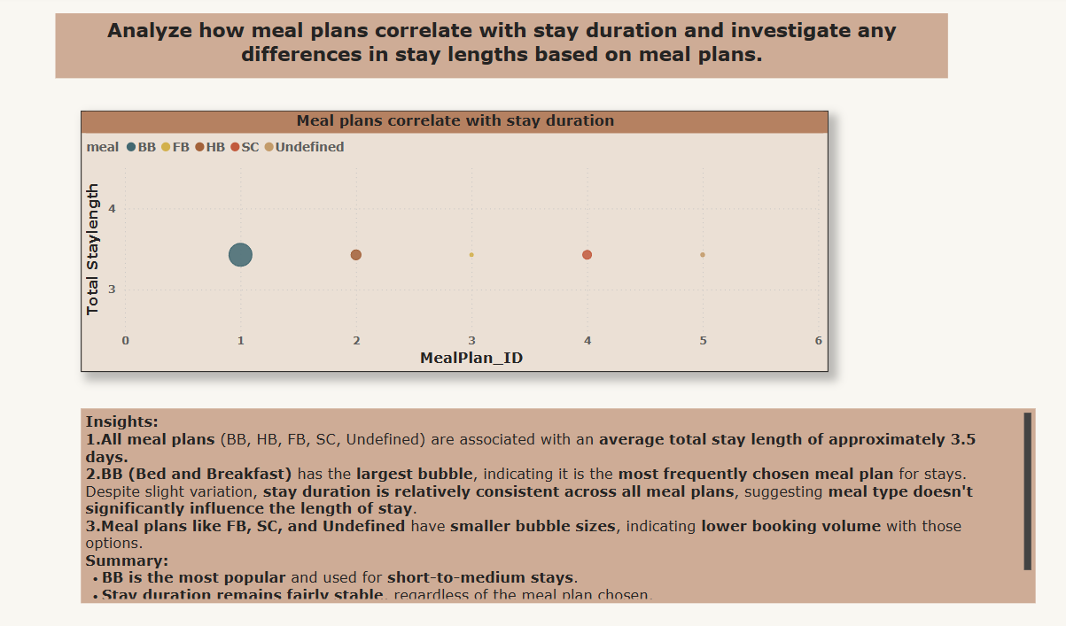

Slide 24
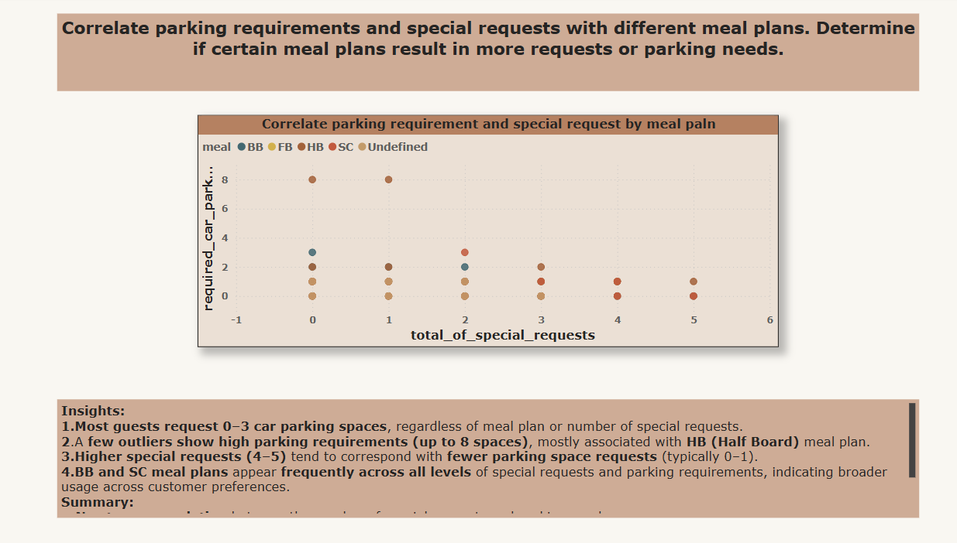

Slide 25
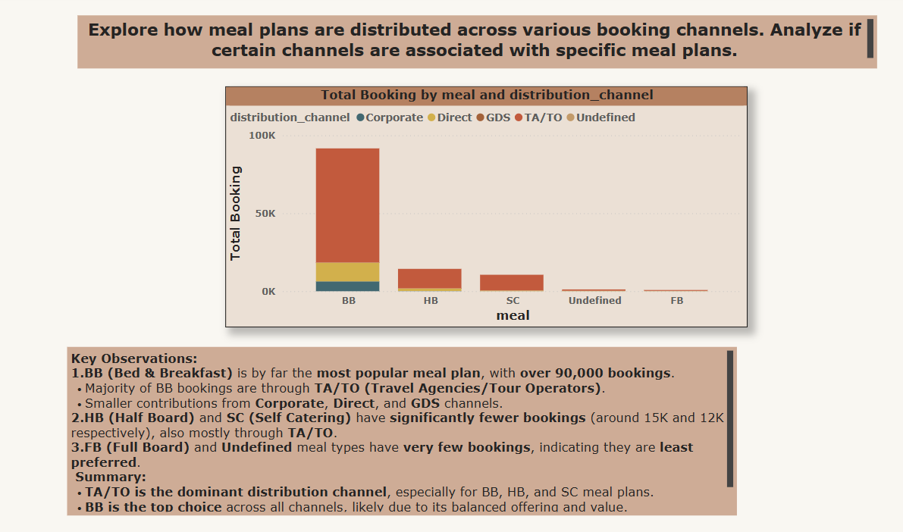

Slide 26
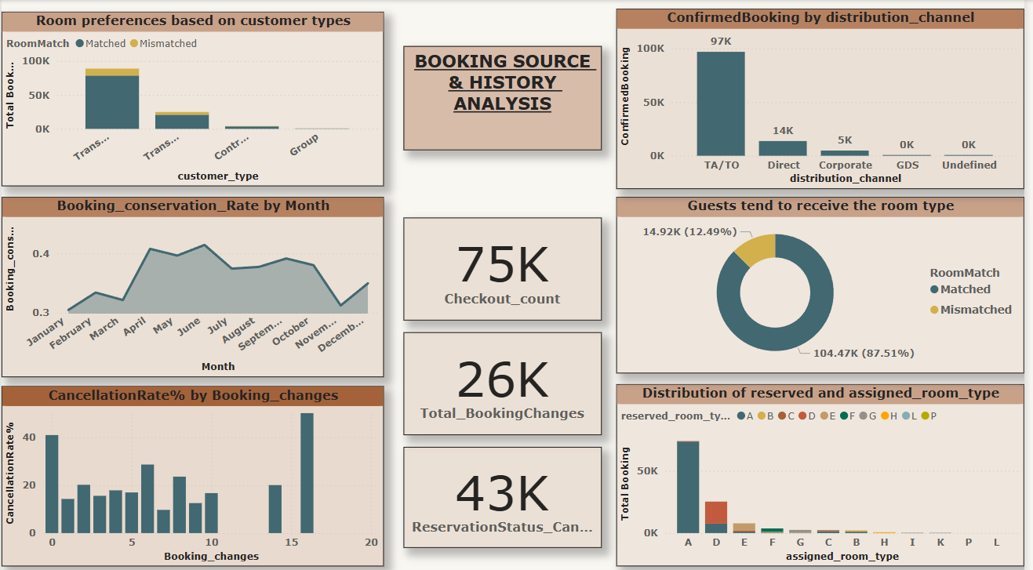

Slide 27
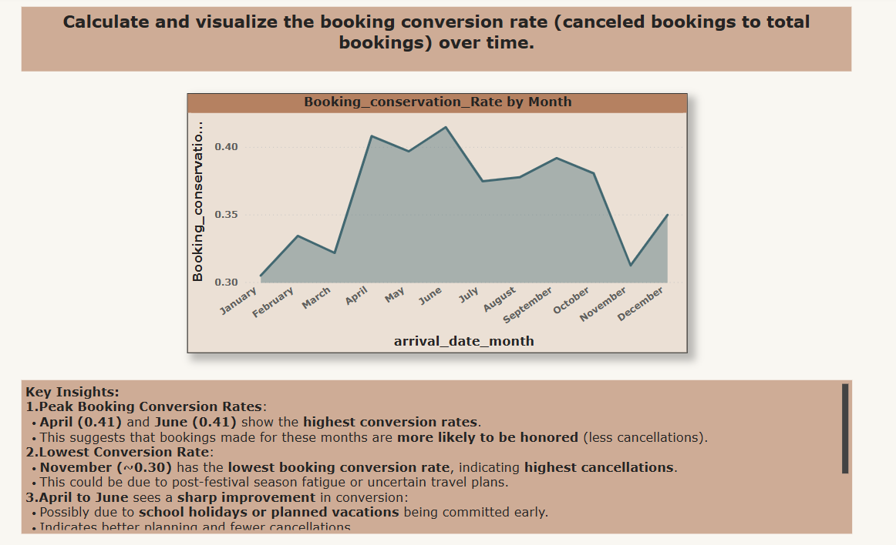

Slide 28
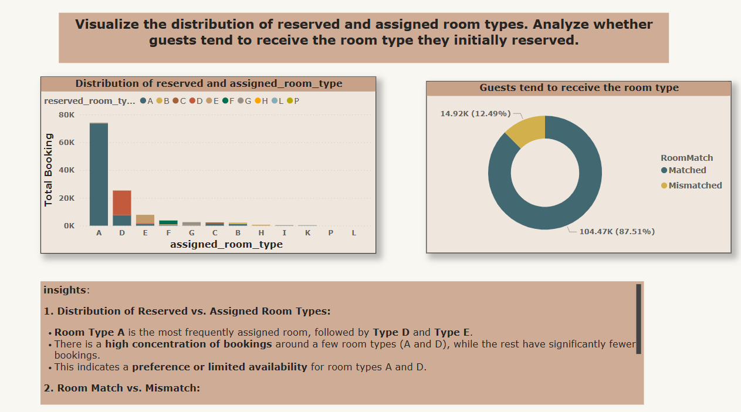

Slide 29
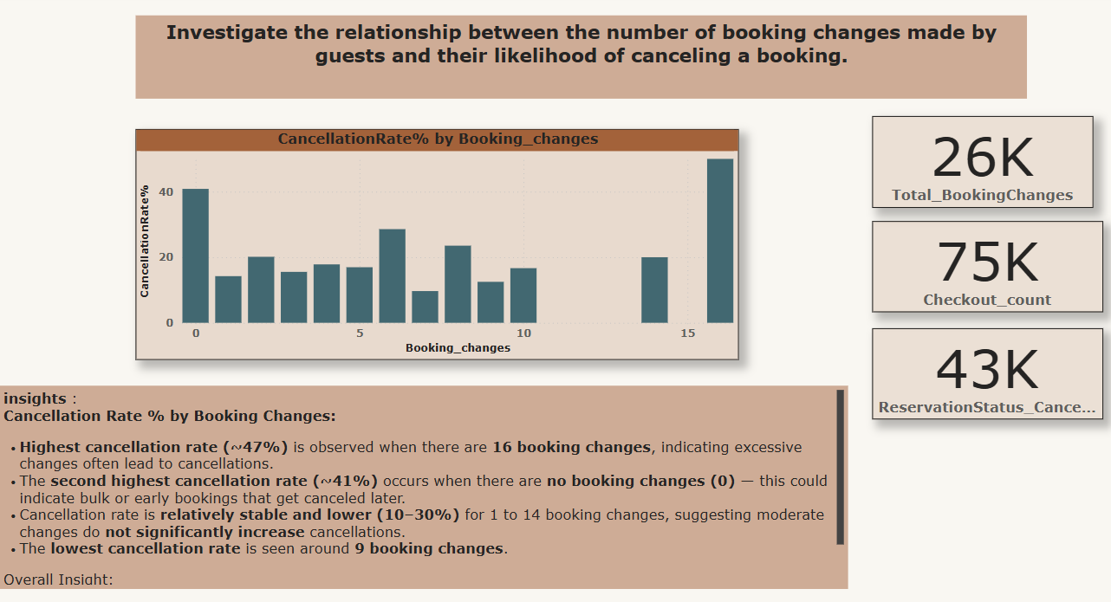

Slide 30
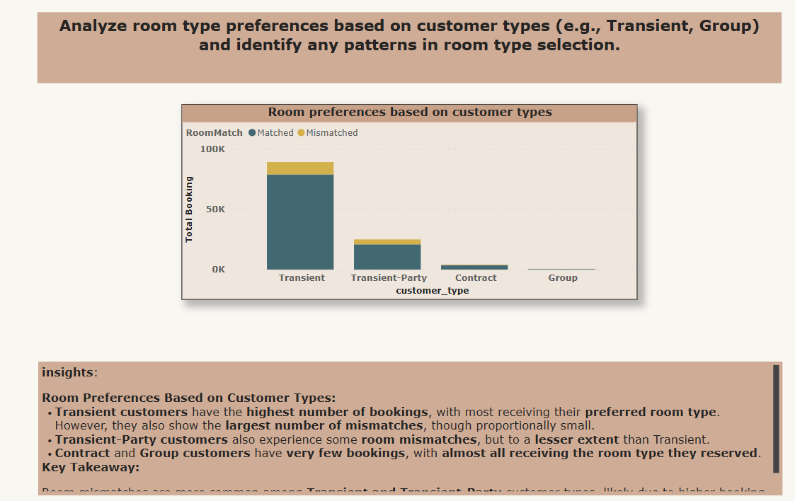

Slide 31
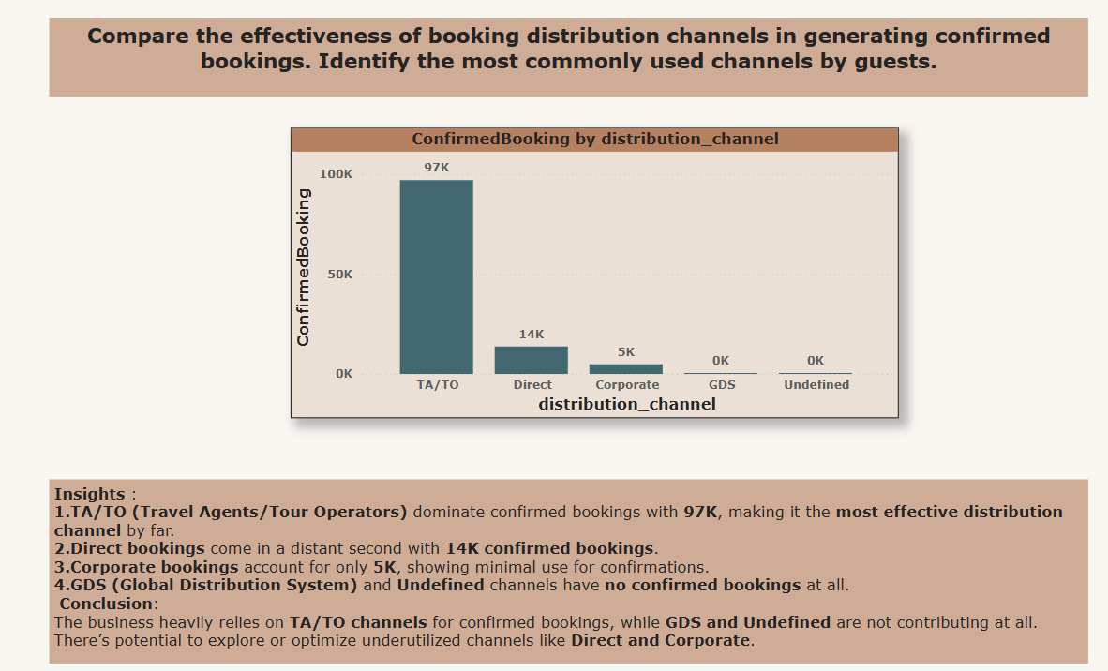

Slide 32
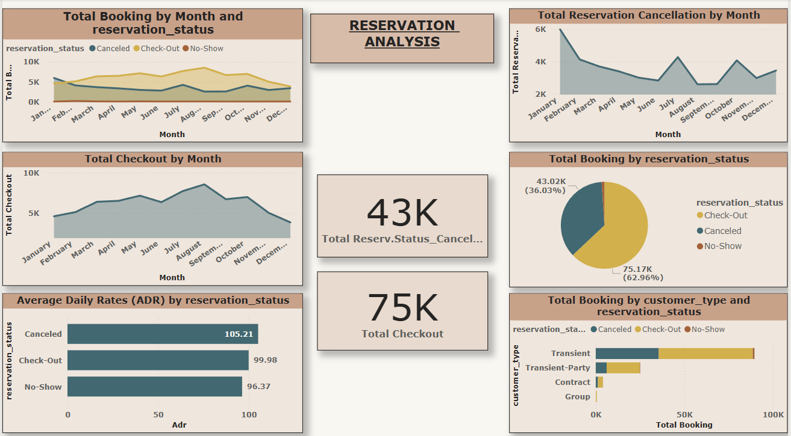

Slide 33
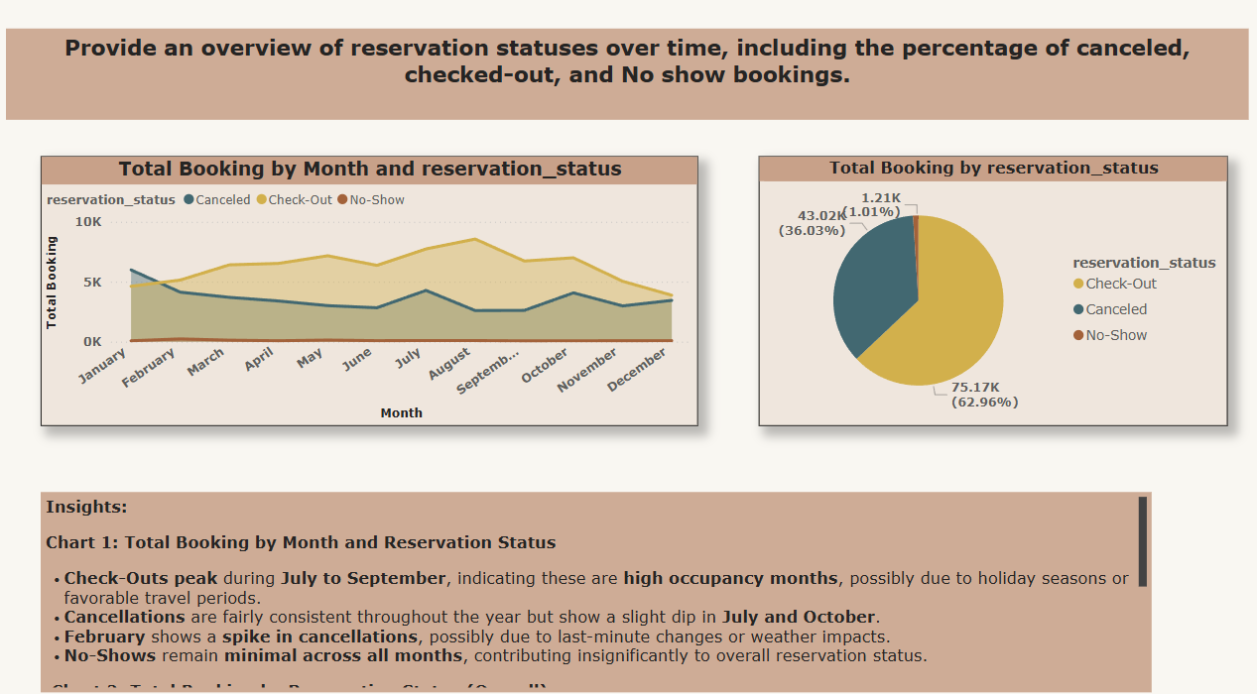

Slide 34
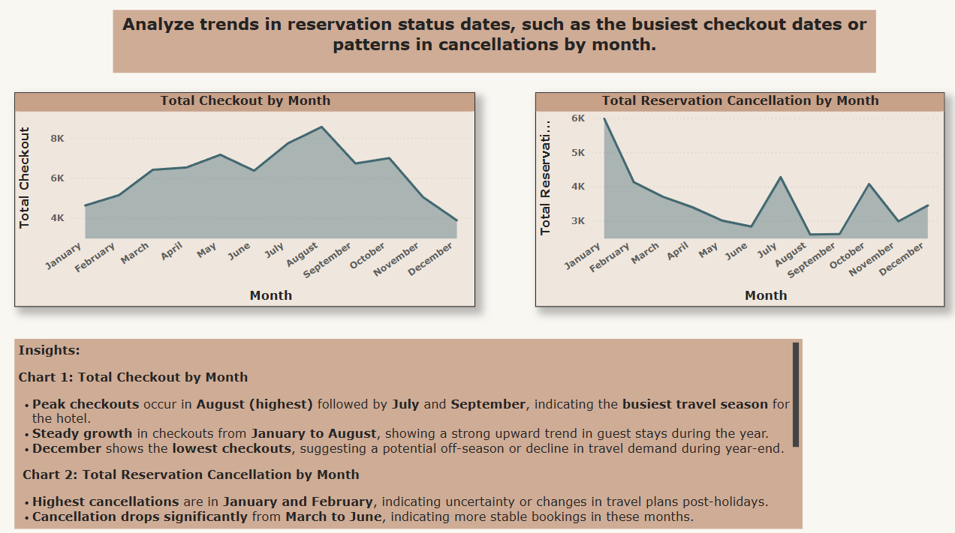

Slide 35
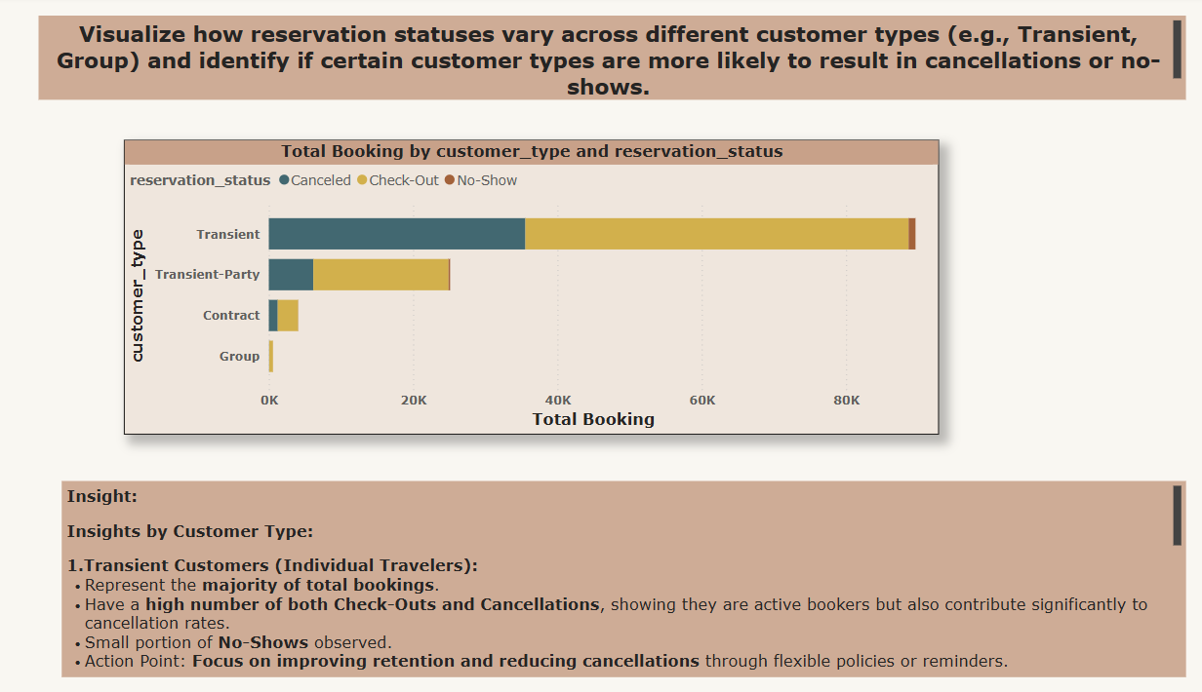

Slide 36
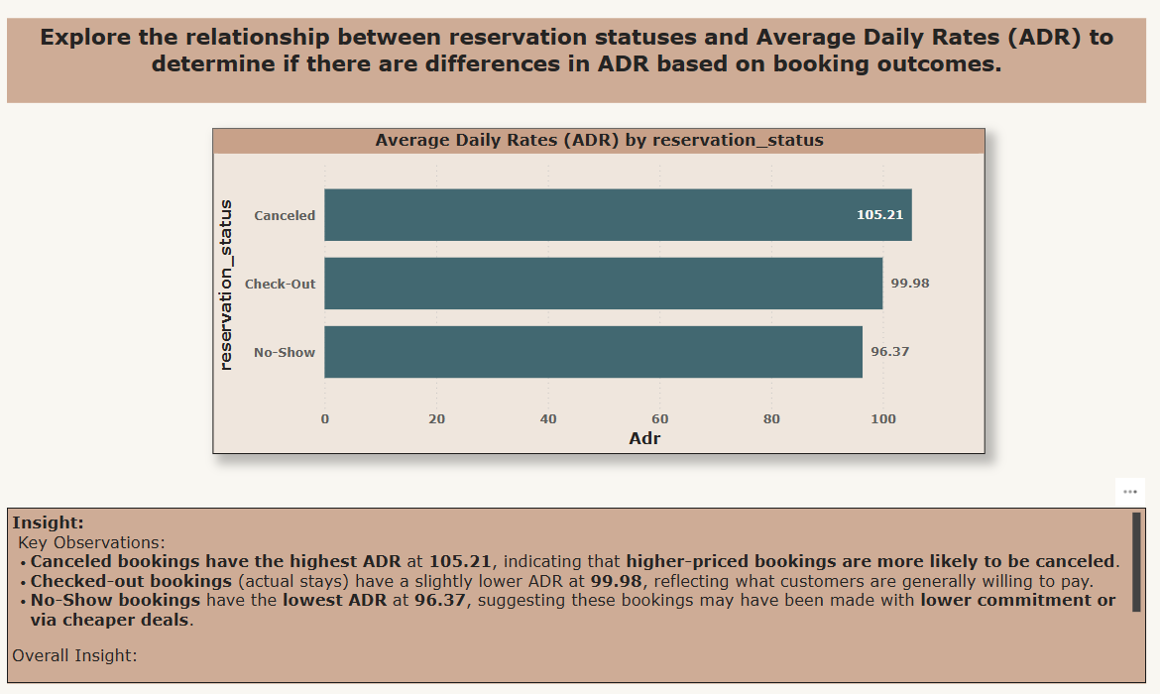

Slide 37
Eda problem statement

Slide 38
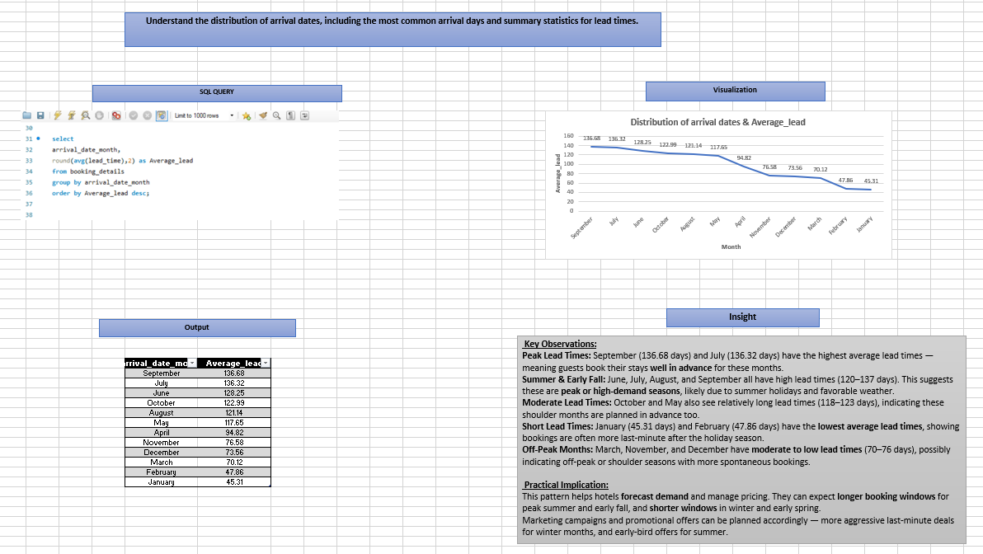

Slide 39
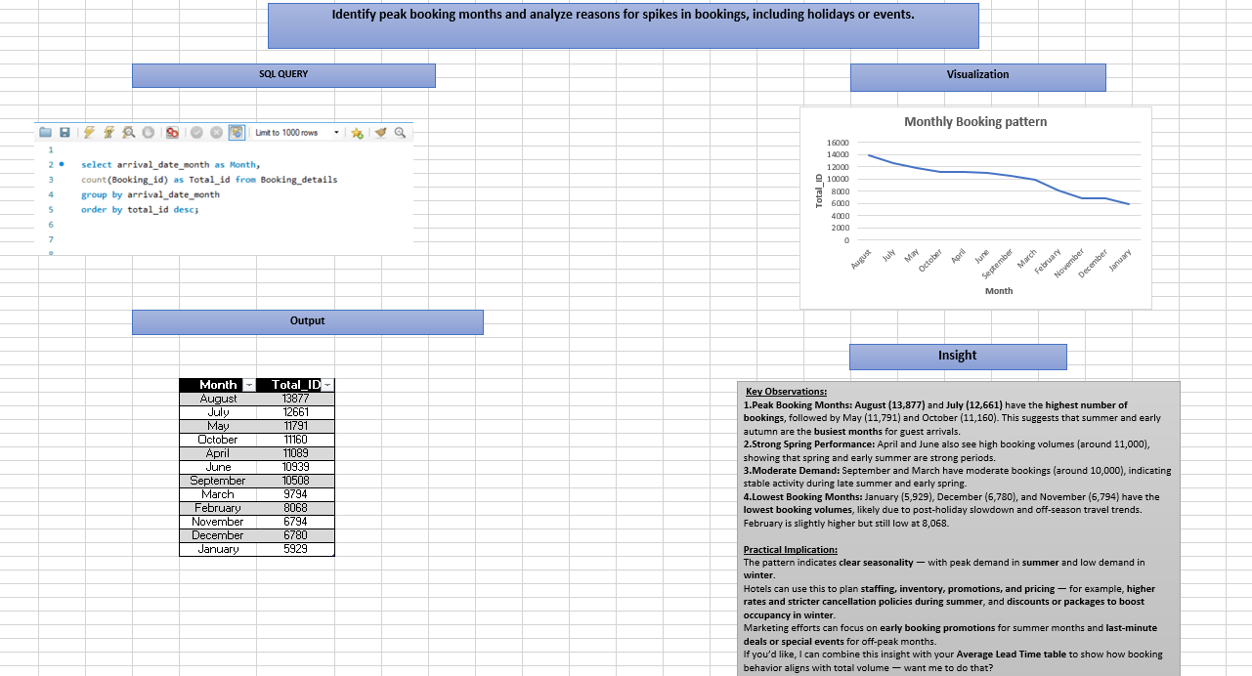

Slide 40
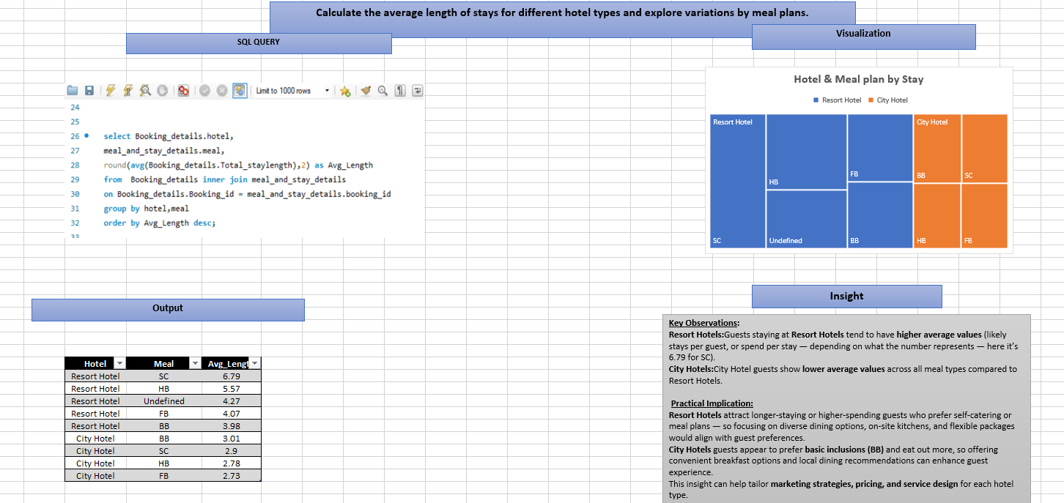

Slide 41
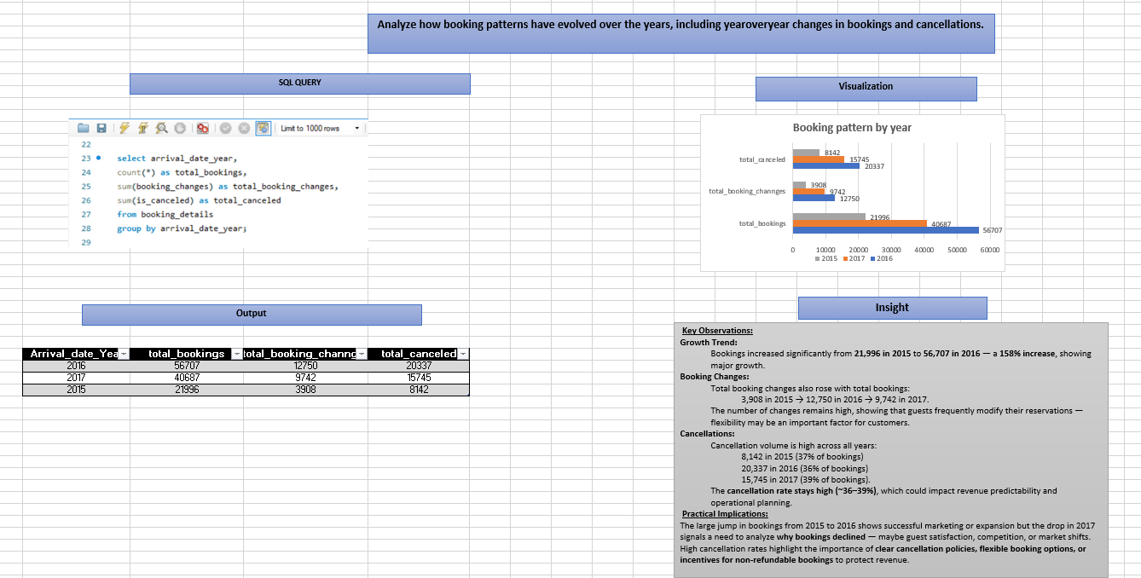

Slide 42
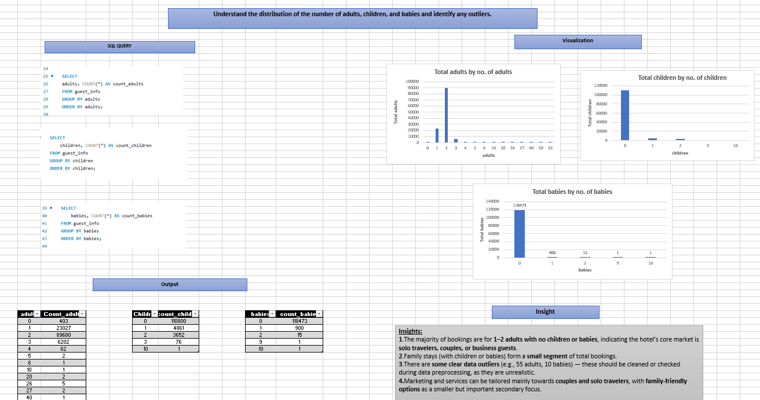

Slide 43
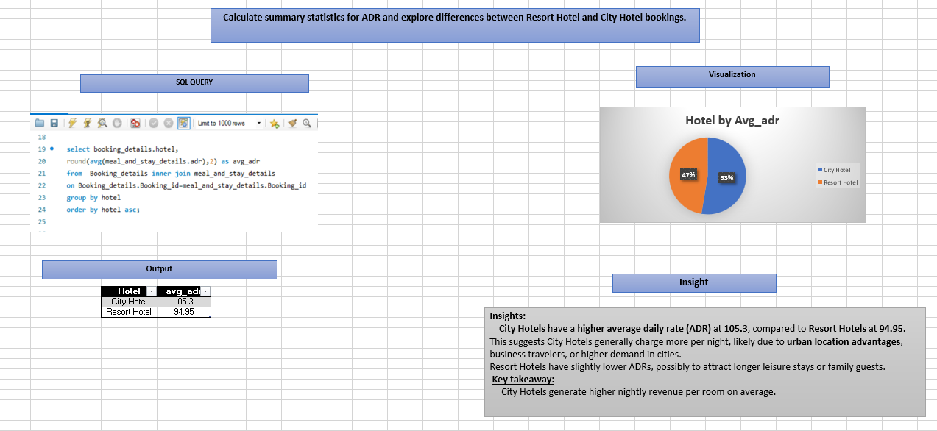

Slide 44
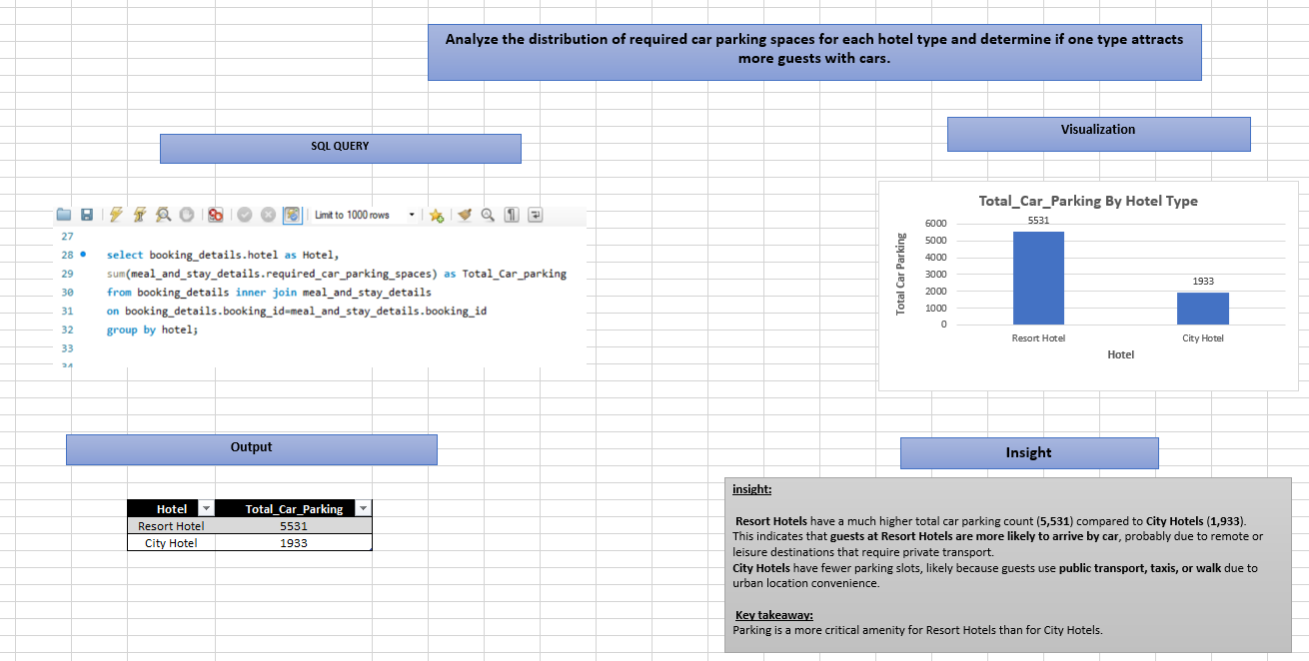

Slide 45
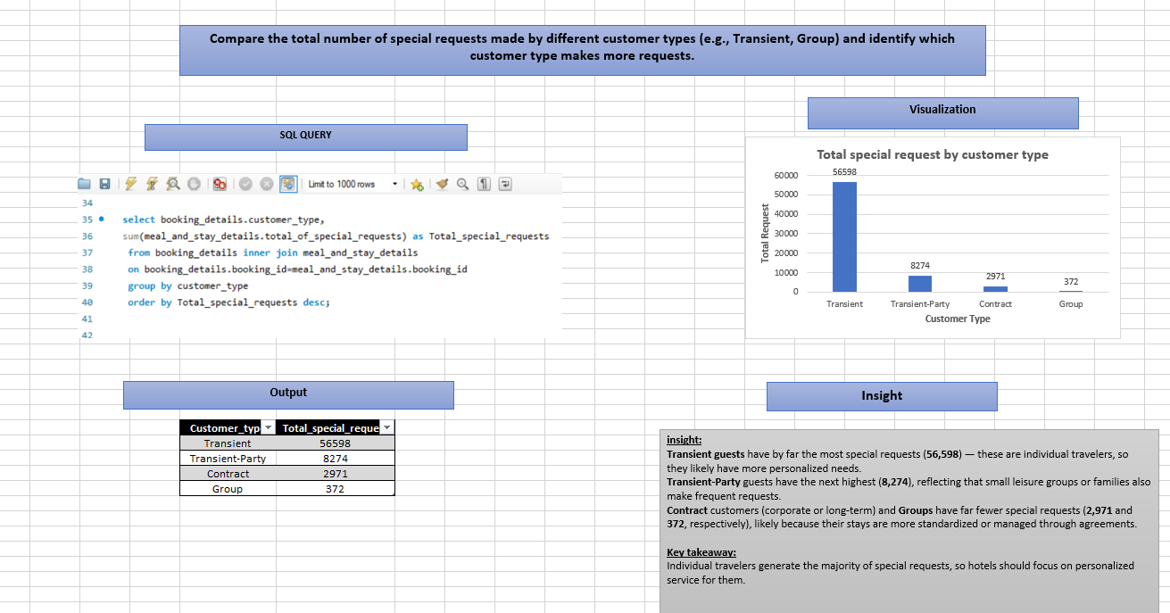

Slide 46
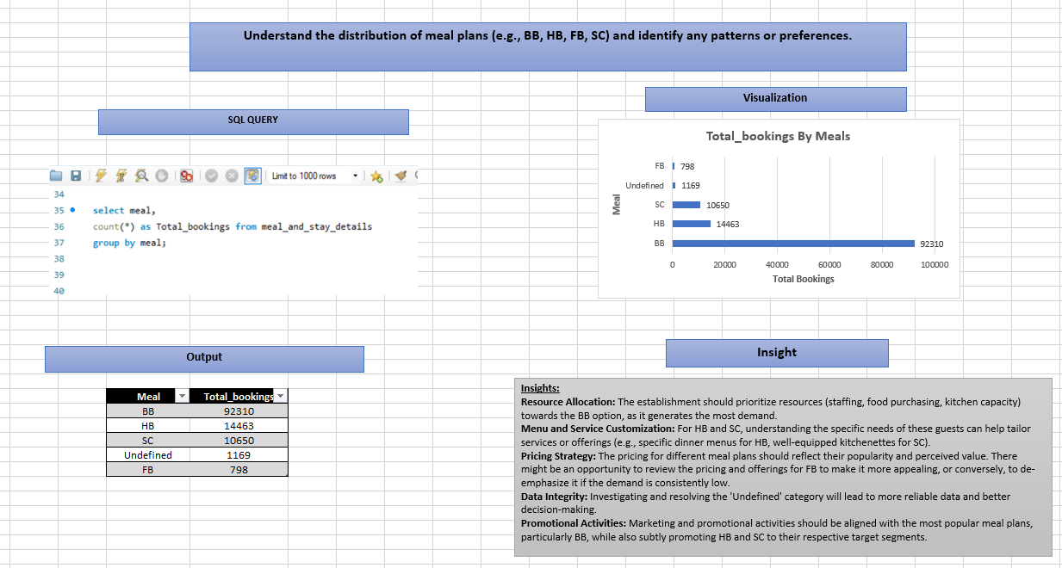

Slide 47
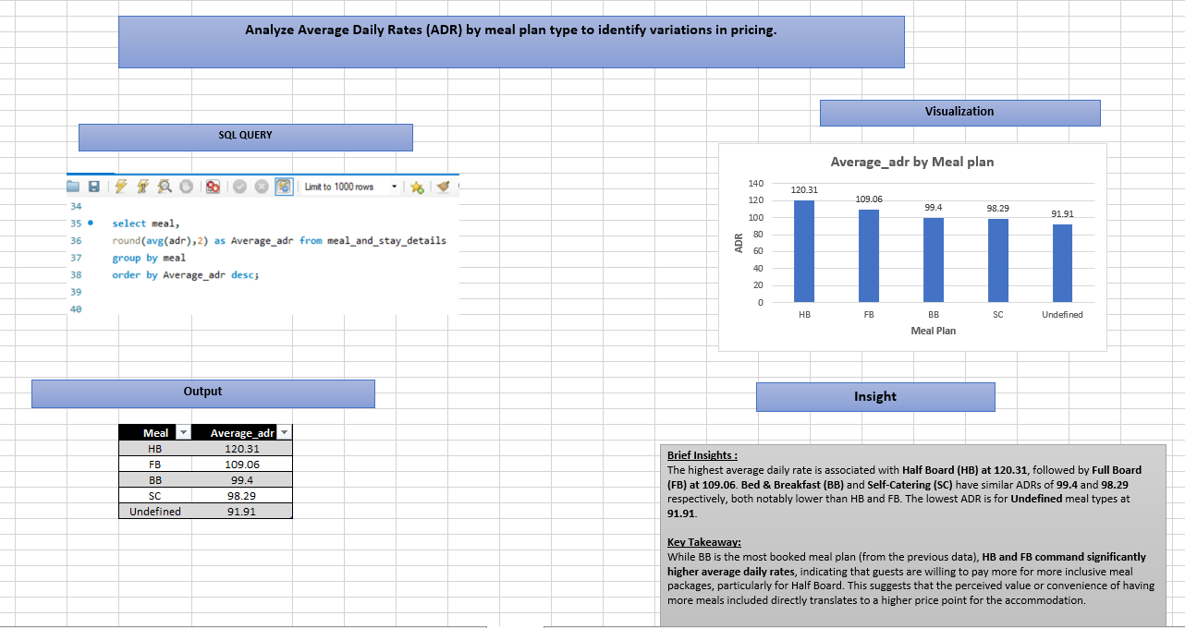

Slide 48
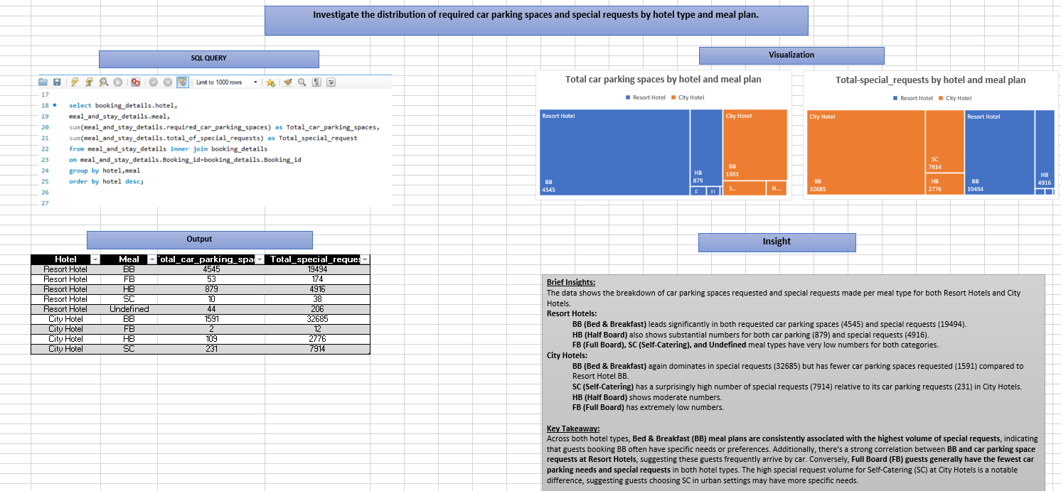

Slide 49
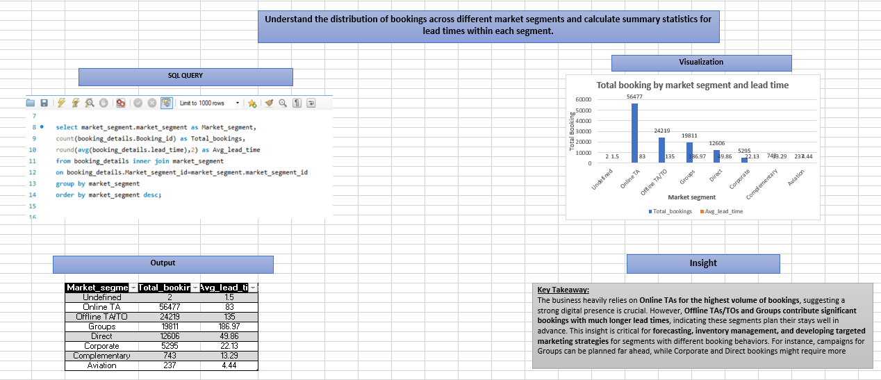

Slide 50
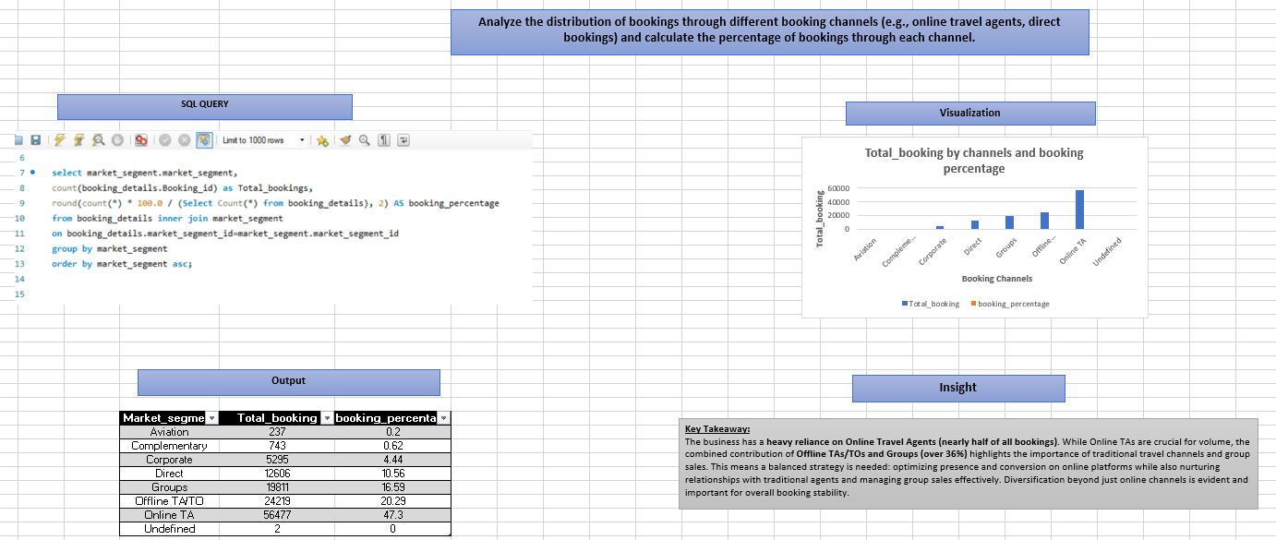

Slide 51
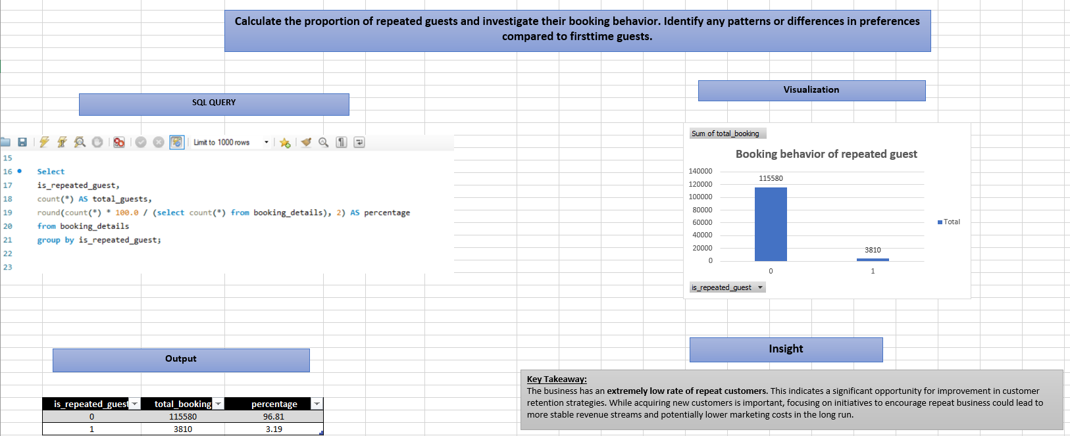

Slide 52
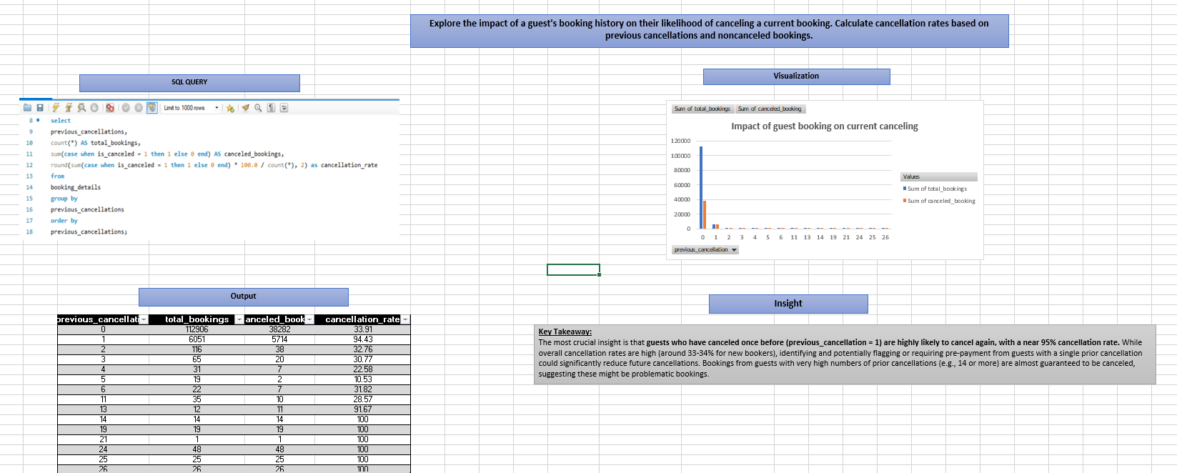

Slide 53
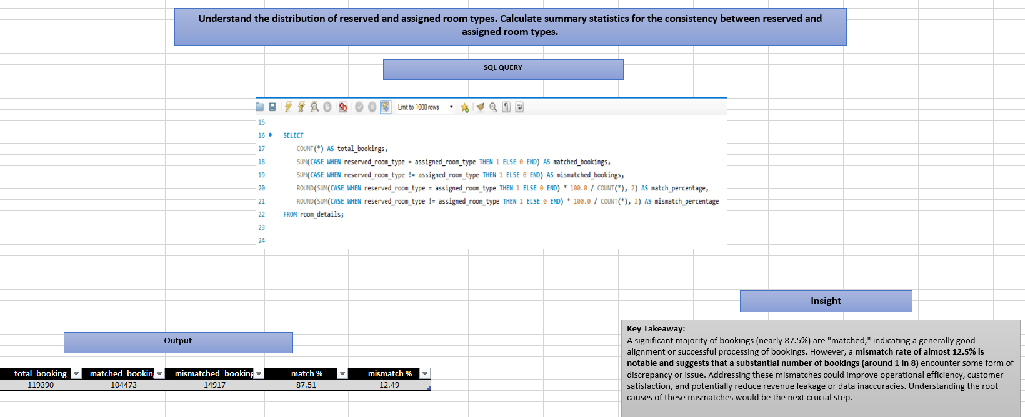

Slide 54
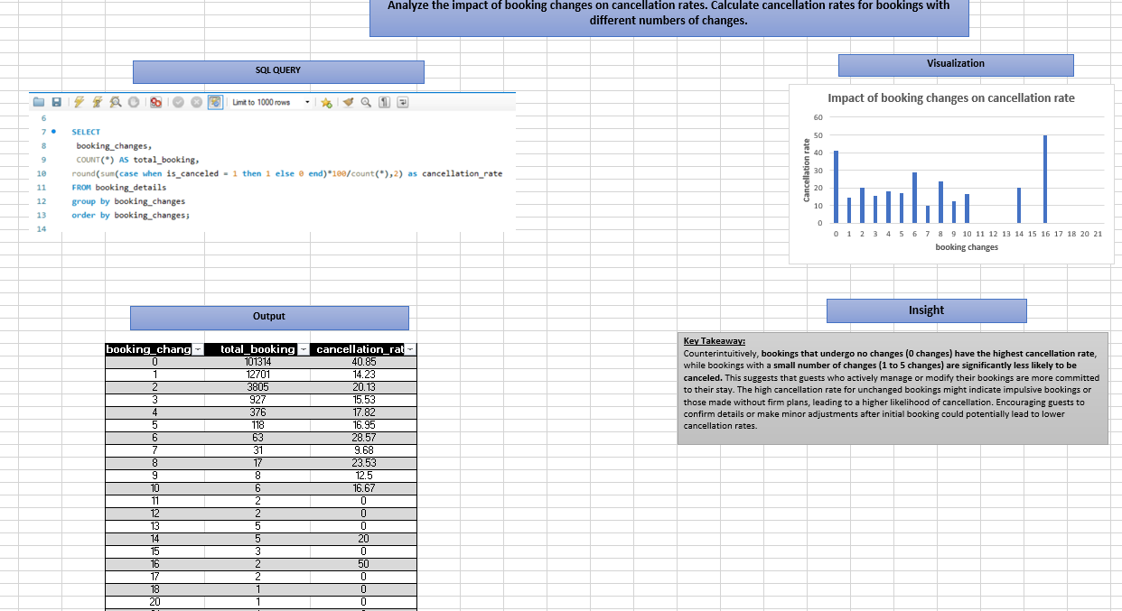

Slide 55
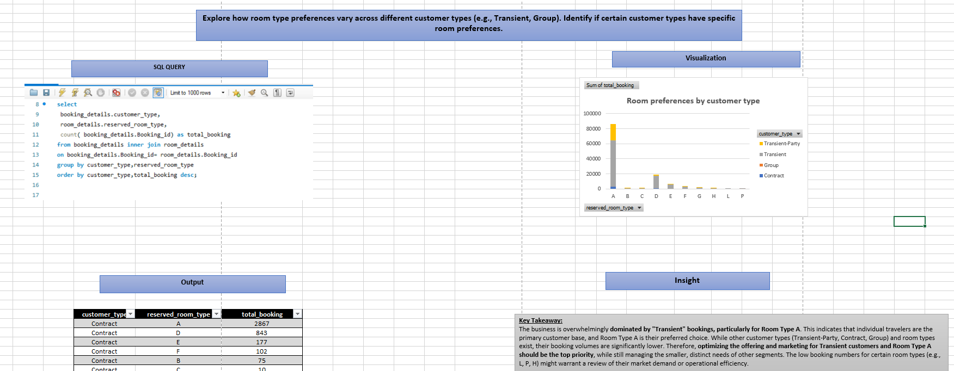

Slide 56
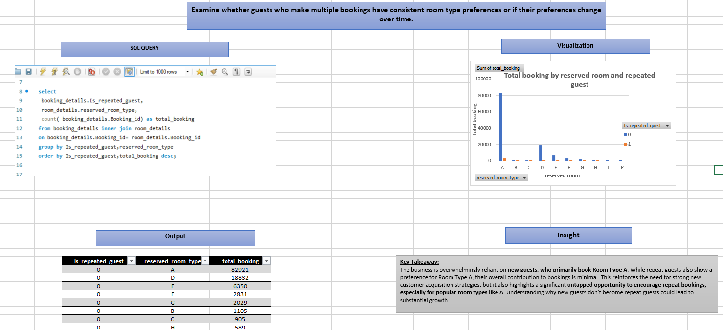

Slide 57
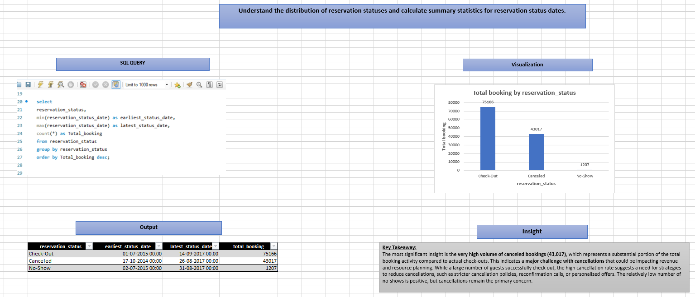

Slide 58


Slide 59


Slide 60


Slide 61


Slide 62
Thank you

